Slide 1
Analysis and Implementations of Streaming Algorithms in Computational Geometry
Shrinivas Acharya
(10010164)
Under the guidance of
Dr. S.V. Rao

Slide 2
Introduction
The problem of finding the minimum spanning tree (MST) has several applications
specifically in design of networks, including computer networks
water supply networks
electric grids etc.
The size of graph is too large to fit inside the main memory so problem of finding the MST in streaming computations arises.

Slide 3
Introduction
This report deals with Finding the minimum enclosing ball (MEB)
The MEB problem has various important applications, which often requires it be solved in relatively high dimensions.
Some of the applications of MEB computation include
gap tolerant classifiers in Machine Learning
tuning Support Vector Machine parameters
Support Vector Clustering

Slide 4
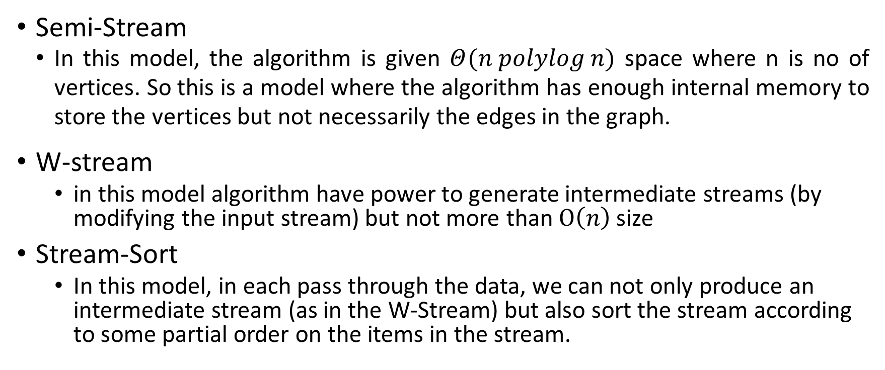
Various Models of Streaming Algorithms
Semi-Stream
In this model, the algorithm is given $Θ(n polylog n)$ space where n is no of vertices. So this is a model where the algorithm has enough internal memory to store the vertices but not necessarily the edges in the graph.
W-stream
in this model algorithm have power to generate intermediate streams (by modifying the input stream) but not more than $Ο\left(n\right)$ size
Stream-Sort
In this model, in each pass through the data, we can not only produce an intermediate stream (as in the W-Stream) but also sort the stream according to some partial order on the items in the stream.

Slide 5
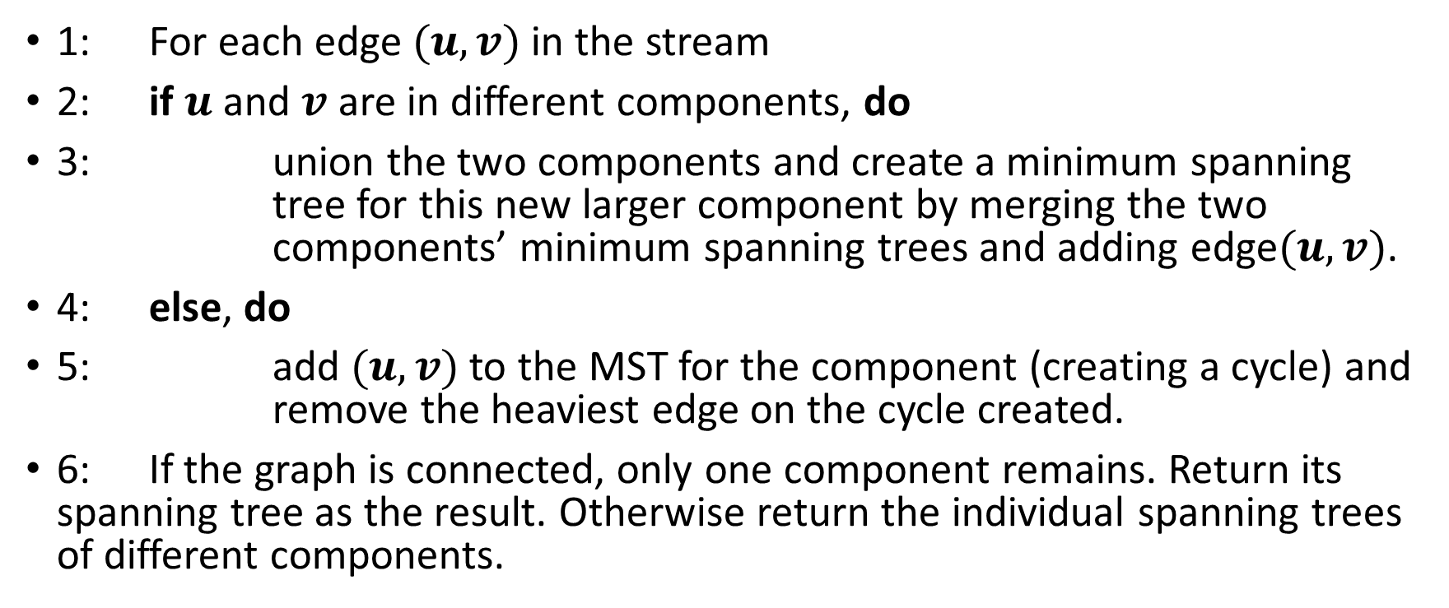
Semi Streaming
1: For each edge $(u,v)$ in the stream
2: if $u$and $v$are in different components, do
3: union the two components and create a minimum spanning tree for this new larger component by merging the two components’ minimum spanning trees and adding edge$(u,v)$.
4: else, do
5: add $(u,v)$ to the MST for the component (creating a cycle) and remove the heaviest edge on the cycle created.
6: If the graph is connected, only one component remains. Return its spanning tree as the result. Otherwise return the individual spanning trees of different components.

Slide 6
Implementations and Results

Slide 7
Implementations and Results

Slide 8
Observations
Approximation factor is increasing with number of edges.
Comparing approximation factor is not a good way to analyze the results.
Error is not increasing with number of edges and it follows same pattern regardless the values of maximum and minimum weights or their differences.

Slide 9
W-Stream
A deterministic W-Stream algorithm for finding the Connected Components (CC) of an undirected
It is an open question whether this W-Stream algorithm for connected components can be extended to find a minimum tree as was done with the Semi-Streaming algorithm for connected components.

Slide 10
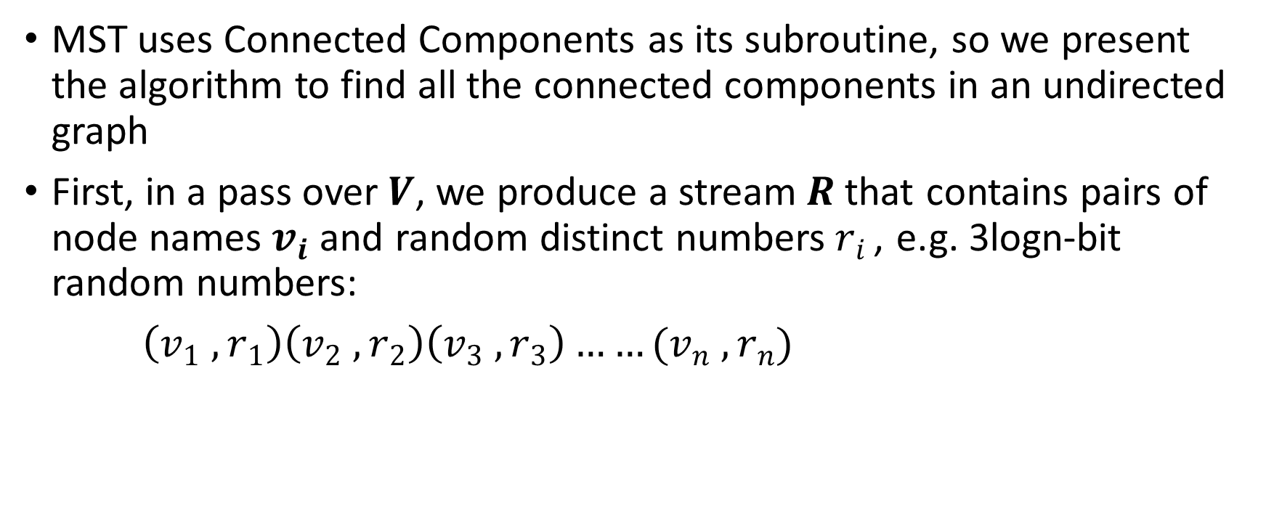
Stream-Sort
MST uses Connected Components as its subroutine, so we present the algorithm to find all the connected components in an undirected graph
First, in a pass over$V$, we produce a stream$R$that contains pairs of node names$v_{i}$and random distinct numbers$r_{i }$, e.g. 3logn-bit random numbers:
$\left(v_{1} , r_{1}\right)\left(v_{2} , r_{2}\right)\left(v_{3} , r_{3}\right)……(v_{n} , r_{n})$

Slide 11
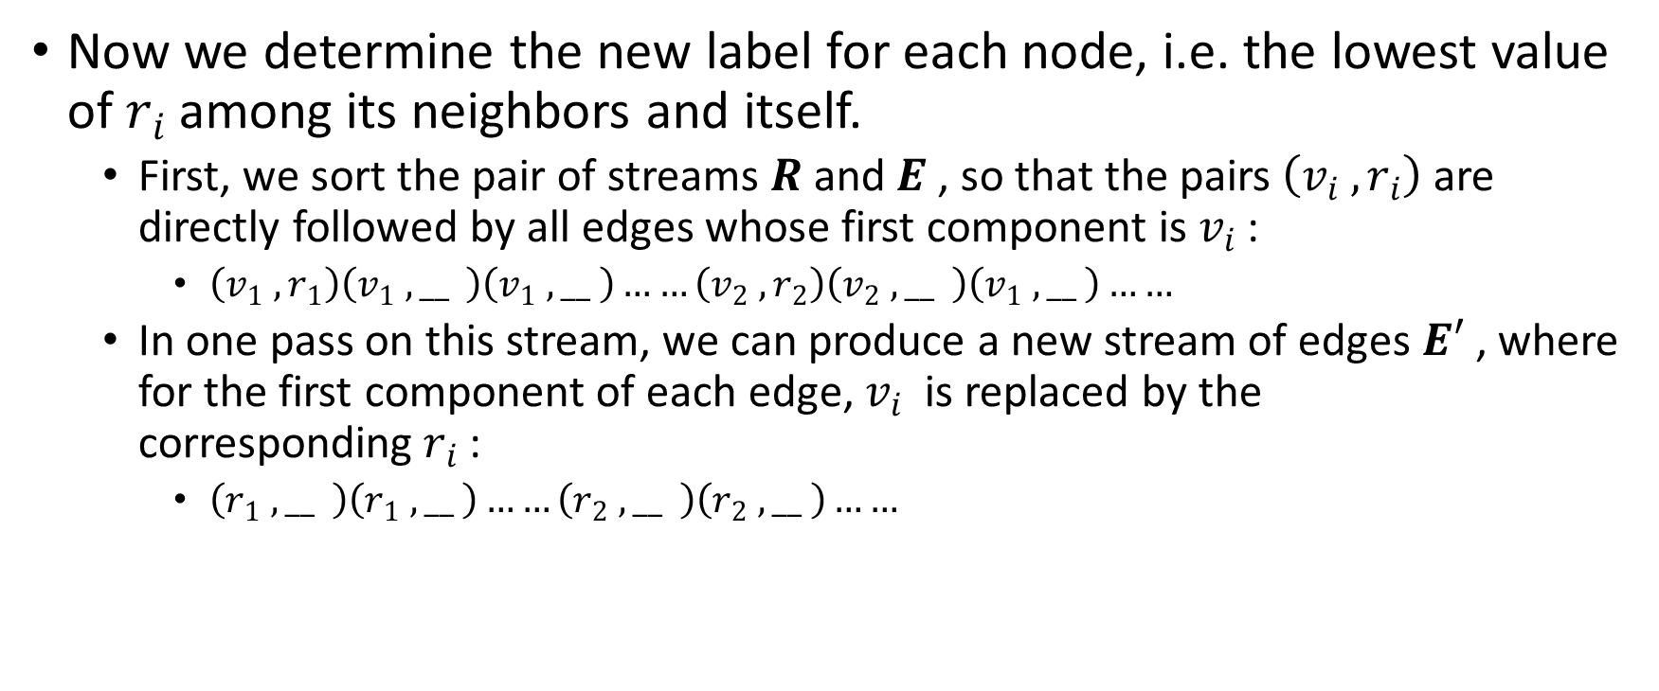
Connected Component Algorithm
Now we determine the new label for each node, i.e. the lowest value of$r_{i}$among its neighbors and itself.
First, we sort the pair of streams$R$and$E$, so that the pairs$\left(v_{i} , r_{i}\right)$are directly followed by all edges whose first component is${ v}_{i}$:
$\left(v_{1} , r_{1}\right)\left(v_{1} , __ \right)\left(v_{1} , __ \right)……\left(v_{2} , r_{2}\right)\left(v_{2} , __ \right)\left(v_{1} , __ \right)……$
In one pass on this stream, we can produce a new stream of edges$E′$, where for the first component of each edge, $v_{i}$ is replaced by the corresponding$r_{i}$:
$\left(r_{1} , __ \right)\left(r_{1} , __ \right)……\left(r_{2} , __ \right)\left(r_{2} , __ \right)……$

Slide 12
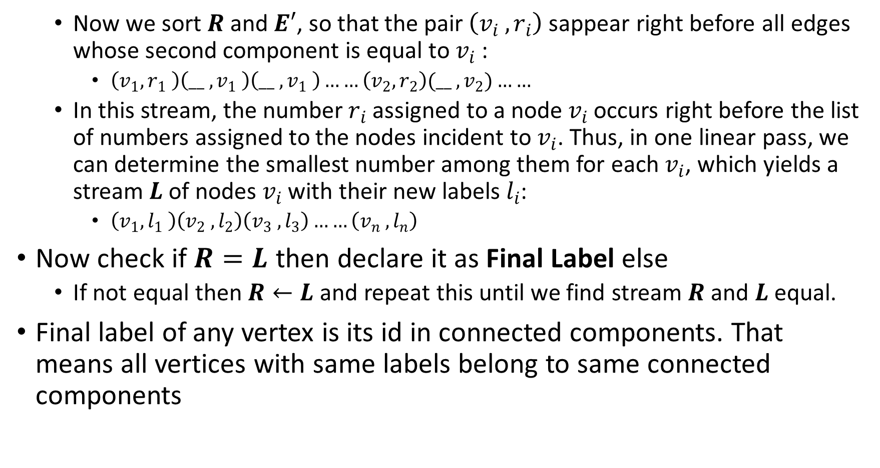
Now we sort$R$and$E′$, so that the pair$\left(v_{i} , r_{i}\right)$sappear right before all edges whose second component is equal to$v_{i}$ :
$\left(v_{1},r_{1} \right)\left(__ ,v_{1} \right)\left(__ ,v_{1} \right)……\left(v_{2},r_{2}\right)(__ ,v_{2})……$
In this stream, the number$r_{i}$assigned to a node$v_{i}$occurs right before the list of numbers assigned to the nodes incident to$v_{i}$. Thus, in one linear pass, we can determine the smallest number among them for each$v_{i}$, which yields a stream$L$of nodes$v_{i}$with their new labels$l_{i}$:
$\left(v_{1},l_{1} \right)\left(v_{2} , l_{2}\right)\left(v_{3} , l_{3}\right)……\left(v_{n} , l_{n}\right)$
Now check if $R=L$ then declare it as Final Label else
If not equal then $R←L$ and repeat this until we find stream $R$ and $L$ equal.
Final label of any vertex is its id in connected components. That means all vertices with same labels belong to same connected components

Slide 13
Implementation of Connected Components Algorithm

Slide 14

Observations
Planner Graphs are not shown as graph takes $Ο\left(n\right)$iterations
Dense graph (nearly complete) takes$Ο\left(1\right)$ iterations.
On an average a graph which is not the above two takes $Ο\left(\log{n}\right)$iterations

Slide 15
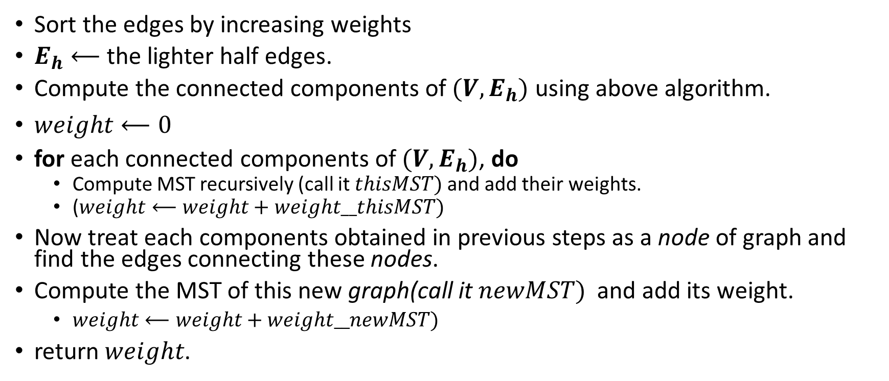
Minimum Spanning Tree in Stream-Sort
Sort the edges by increasing weights
$E_{h}⟵$the lighter half edges.
Compute the connected components of$(V,E_{h})$ using above algorithm.
$weight⟵0$
for each connected components of$(V,E_{h})$, do
Compute MST recursively (call it$thisMST)$and add their weights.
($weight⟵weight+weight__thisMST)$
Now treat each components obtained in previous steps as a node of graph and find the edges connecting these nodes.
Compute the MST of this new graph(call it$newMST)$ and add its weight.
$weight⟵weight+weight__newMST)$
return$weight$.

Slide 16
Implementations and Results

Slide 17
Observations
As the algorithm is using sorting, so it was expected to give better bound than Semi-Streaming
We can see it as a very good streaming version of Kruskal’s algorithm

Slide 18
An approximate Algorithm to Find Minimum Enclosing Ball in Higher Dimensions
An approximate streaming algorithm for computing the minimum enclosing ball (MEB) of n points was implemented in BTP phase 1
The algorithm had an approximation factor 1.5
Now we present an algorithm with (1+√3)/2 + ϵ approximation factor.

Slide 19
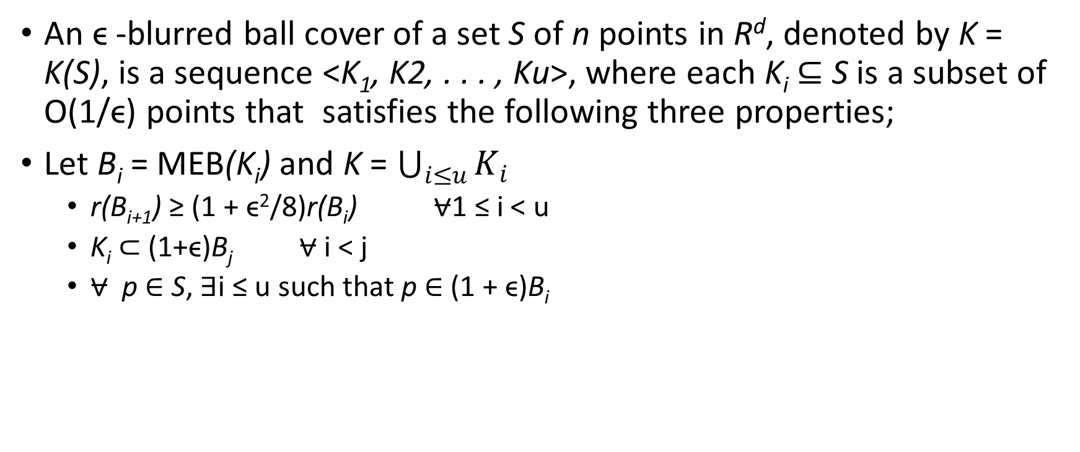
Blurred Ball Cover
An ϵ -blurred ball cover of a set S of n points in R^{d}, denoted by K = K(S), is a sequence <K₁, K2, . . . , Ku>, where each K_{i} ⊆ S is a subset of O(1/ϵ) points that satisfies the following three properties;
Let B_{i} = MEB(K_{i}) and K = $\bigcup_{i≤u}{K_{i}}$
r(B_{i+1}) ≥ (1 + ϵ²/8)r(B_{i}) $⩝$1 ≤ i < u
K_{i} ⊂ (1+ϵ)B_{j} $⩝$ i < j
$⩝$ p ∈ S, ∃i ≤ u such that p ∈ (1 + ϵ)B_{i}

Slide 20
Algorithm to Find Core-Set used as Subroutine
If the smallest ball containing S(core-set) is expanded by 1 + ϵ, then the expanded ball contains P.
We will use the algorithm given by Mihai Badoiu and Kenneth L. Clarkson to find the core-set.

Slide 21
Algorithm to maintain Blurred Ball Cover
Algorithm use a simple procedure called Update(K,A), that given K := K(S) and a set of A⊂R^{d}, computes K(S ∪ A).
Update(K,A)
1: if ∃p ∈ A, ∀i ≤ u, p does not belong to (1 +ϵ)Bi then
2: K∗,B∗ := Approx-MEB((K ∪ A), ϵ/3).
3: K_{D} := {K_{i} | r(B_{i}) ≤ ϵr(B∗)/4}
4: K := (K \ K_{D}) օ <K∗>
5: end if

Slide 22
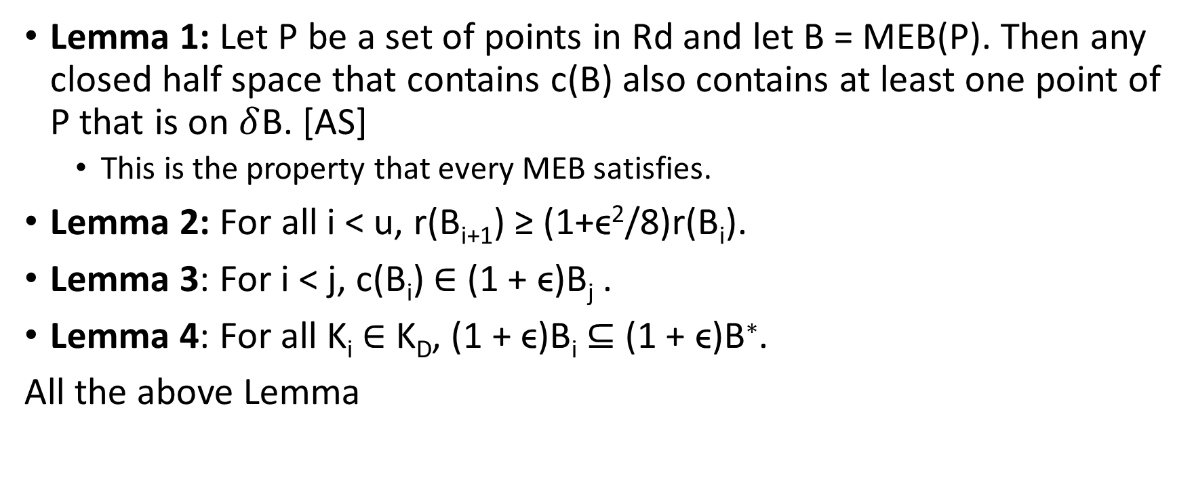
Update Procedure Maintains Blurred-Ball-Cover
Lemma 1: Let P be a set of points in Rd and let B = MEB(P). Then any closed half space that contains c(B) also contains at least one point of P that is on $δ$B. [AS]
This is the property that every MEB satisfies.
Lemma 2: For all i < u, r(B_{i+1}) ≥ (1+ϵ²/8)r(B_{i}).
Lemma 3: For i < j, c(B_{i}) ∈ (1 + ϵ)B_{j} .
Lemma 4: For all K_{i} ∈ K_{D}, (1 + ϵ)B_{i} ⊆ (1 + ϵ)B∗.
All the above Lemma

Slide 23
Space Complexity
Let r_{i} = r(B_{i}).
Update ensures that r_{u}/r₁ ≤ 4/ϵ. By (P1), r_{i+1} ≥ (1+ϵ²/8)r_{i}.
Therefore r_{u} ≥ (1+ϵ²/8)^{u}r₁.
Which gives u ≤ ⌈log_{1+ϵ2/8}(4/ϵ)⌉ = O((1/ϵ²) log(1/ϵ)).
Hence for any 0 < ϵ ≤ 1, an ϵ -blurred ball cover of size O((d/ϵ³) log(1/ϵ)) of a stream of points can be maintained

Slide 24
Implementations and Results(ϵ = 0.1)

Slide 25
Implementations and Results(ϵ = 0.1)

Slide 26
Implementations and Results(ϵ = 0.1)

Slide 27
Implementations and Results(ϵ = 0.3)

Slide 28
Use Blurred-Ball To Find MES
For a stream S of points, we maintain a (ϵ/9)-blurred ball cover K of S using above Update procedure.
K is updated whenever a new point arrives.
Let B = {B₁, . . . ,B_{u}}. Let B∗ = MEB(B). We return (1+ϵ/3)B∗ which can be computed in time O(1/ϵ⁵) .
We will directly use the results proved in that returned ball has maximum size ( (1 + √3 )/2 + ϵ/3)r, where r is r(MEB(S)).

Slide 29
Implementations and Results(ϵ = 0.1)

Slide 30
Implementations and Results(ϵ = 0.1)

Slide 31
Implementations and Results(ϵ = 0.1)

Slide 32
Implementations and Results(ϵ = 0.3)

Slide 33
Observations
No instance crossed the upper bound.
None went below a certain value
Does above algorithm has some lower bound, say 1.3 or 1.2?
Similar results were found for different values of epsilon
Can the observed lower bound (empirical lower bound) be justified theoretically ? (Open Problem)

Slide 34
References
Gagan Aggarwal, Mayur Datar, Sridhar Rajagopalan, and Matthias Ruhl. On the streaming model augmented with a sorting primitive. In FOCS ’04: Proceedings of the 45th Annual IEEE Symposium on Foundations of Computer Science (FOCS’04), pages 540–549, Washington, DC, USA, 2004. IEEE Computer Society
Camil Demetrescu, Irene Finocchi, and Andrea Ribichini. Trading off space for passes in graph streaming problems. In SODA ’06: Proceedings of the seventeenth annual ACMSIAM symposium on Discrete algorithm, pages 714–723, New York, NY, USA, 2006. ACM Press
Joan Feigenbaum, Sampath Kannan, Andrew McGregor, Siddharth Suri, and Jian Zhang. Graph distances in the streaming model: the value of space. In SODA ’05: Proceedings of the sixteenth annual ACM-SIAM symposium on discrete algorithms, pages 745–754, Philadelphia, PA, USA, 2005. Society for Industrial and Applied Mathematics
Joan Feigenbaum, Sampath Kannan, Andrew McGregor, Siddharth Suri, and Jian Zhang. On graph problems in a semi-streaming model. Theoretical Computer Science, 348(2-3):207–216, 2005
Matthias Ruhl. Efficient Algorithms for New Computational Models. Ph.D. Thesis, MIT, Cambridge, MA, USA, 2001
Robert Endre Tarjan. Data structures and network algorithms. Society for Industrial and Applied Mathematics, Philadelphia, PA, USA, 1983.
M. B˘adoiu and K. L. Clarkson, Optimal core-sets for balls, Comput. Geom. Theory Appl., 40 (2008), 14–22
Streaming algorithms for extent problems in higher dimensions. Pankaj Agrawal, R.SharatKumar

Slide 35
Thank you

